Slide 1
Peeking Around Corners: Visa/Travel and Immigration Compliance Concerns for In-House Counsel
2021 Lavender Law® Conference & Career Fair, Corporate Counsel Institute

Slide 2
Meet the Panel
Jake Campbell (Moderator); Managing Associate, Seyfarth Shaw, LLP
Allen Orr, Founder, Orr Immigration Law Firm PC; President-Elect, American Immigration Lawyers Association (AILA)
Michele Frangella, Director, Global Mobility/Americas, Re:Sources, A Publicis Groupe Company
Douglas Hauer, Member, Mintz, Levin, Cohn, Ferris, Glovsky and Popeo, P.C.; Lecturer, Boston University School of Law
Kai Lo, Senior Corporate Counsel, Amazon

Slide 3
Topics of Discussion
Travel: (i) COVID-19 travel bans (US and global bans); (ii) consular closures and impact on companies/individuals (immigration/tax/employment issues); (iii) COVID-19 passport.
Compliance: (i) I-9/E-Verify Enforcement; (ii) virtual I-9s and compliance issues; (iii) IER/DOJ issues; (iv) WHD; (v) immigration compliance in M&A context

Slide 4
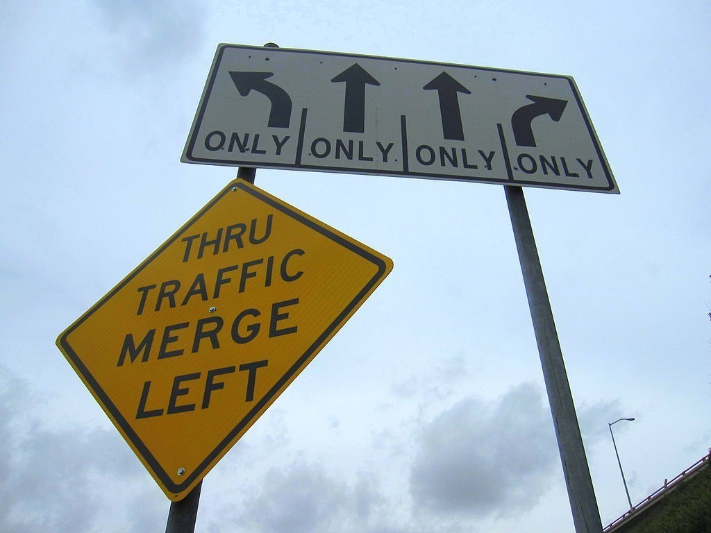
Travel Bans
United States
Global
Federal bans
State restrictions
Issues for international travel
Quarantine/impact on business

Slide 5
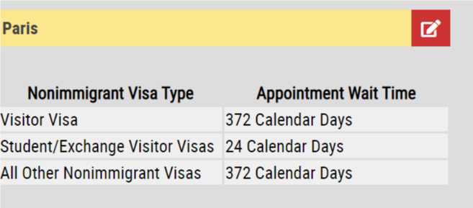
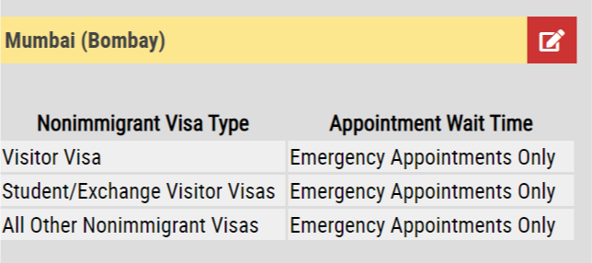
Visas and COVID-19
COVID-19 and impact on U.S. Department of State.
What’s happening with DOS?

Slide 6
Employees Stuck Abroad
Impact on business: employment issues, tax, etc.?
What can companies do?

Slide 7
COVID “Passport”
Federal COVID passport and travel
State issues
Global COVID passport/impact on employees traveling internationally

Slide 8
Business Immigration Compliance & What to Expect

Slide 9
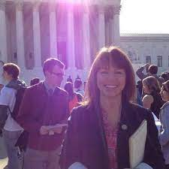
Biden-Harris Changes to Immigration: 1,000-Foot Overview
White House
Esther Olavarria
Tyler Moran
DHS
Alejandro Mayorkas
Secretary
USCIS
Ur Jaddou
Director Nominee

Slide 10
I-9 Enforcement
What is an I-9?
Who completes this form in my organization?
How to minimize liability?
I-9 audit (by whom)?
I-9 software?
Record retention?
Training?
I-9 Fines
Criminal
Felony and Misdemeanor leading to
Imprisonment, Fines and Forfeiture
Admin Fines
Knowing Hire Violations $583 - $23,331
Paperwork Violations $234 - $2,332
Debarment
Prohibits Federal Contracts for 1-3 years
Effected through Executive Order 2/13/1996

Slide 11
I-9 and COVID-19
Virtual I-9 Inspection
What is ICE’s current policy?
What should in-house counsel do?

Slide 12
E-Verify
What is E-Verify?
Who is required to use E-Verify and what are the risks?
Spring cleaning/record updates?

Slide 13
Visa Sponsorship Policies & Compliance
Why do companies sponsor foreign talent?
Should my organization have a policy on visa sponsorship?
What does the future look like for sponsorship and how should my company prepare?

Slide 14
Sponsorship Compliance: Increased Activity with IER
What is the IER?
What does it do?
Who is a protected worker under the INA?
Immigrant and Employee Rights Section (IER), under the Department of Justice, is responsible for enforcing the anti-discrimination provision of the Immigration and Nationality Act (INA), which protects U.S. citizens and certain other work-authorized individuals from employment discrimination based upon citizenship or immigration status.
Investigates/issues fines for: 1) Citizenship status discrimination in hiring, firing, or recruitment or referral for a fee, 2) National origin discrimination in hiring, firing, or recruitment or referral for a fee, 3) Unfair documentary practices during the employment eligibility verification, Form I-9 and E-Verify, and 4) Retaliation or intimidation.
U.S. citizens, non-citizen nationals, refugees, asylees, and recent lawful permanent residents.
The law has an exception if an employer or recruiter is required to limit jobs due to a law, regulation, executive order, or government contract.

Slide 15
Recent Examples of the IER
Total fines of $1.2 million since 2017:
Employer receiving $37k penalty and monitoring by the IER for prohibiting Lawful Permanent Residents (LPR) from performing a position subject to the International Traffic in Arms Regulations (ITAR).
Employer subject to back-wage liability, civil penalties and two-year IER monitoring for requiring an LPR to provide more work authorization documents when he already presented his green card (generally, do not “re-verify” LPR holders).
**Training is key**

Slide 16
U.S. Department of Labor’s Wage and Hour Division (WHD)
Investigates and enforces certain wage provisions under the INA for the following statuses: D-1, E-3, H-1B, H-1B1, H-1C, H-2A, and H-2B.
Examples of non-compliance?
What is the potential liability?
What can OGC’s office do to minimize liability?

Slide 17
Immigration Compliance in the M&A Context
Immigration due diligence during an M&A – why is it necessary?
What should OGC be reviewing: non-immigrant status, green cards, I-9s, etc.?

Slide 18
Organizational Structure & Risk with Immigration
Immigration is largely HR-driven in most organizations.
Legal can serve in a helpful way to internal clients and to minimize company’s risk – organization and communication are key.

Slide 19
Q&A

